Slide 1
Formally Secure Compartmentalizing Compilation
Cătălin Hrițcu
Inria Paris
Notes:
I'm Catalin and I will tell you about my formally secure compartmentalizing compilation. Don't worry, I'll explain what all these things are.

Slide 2



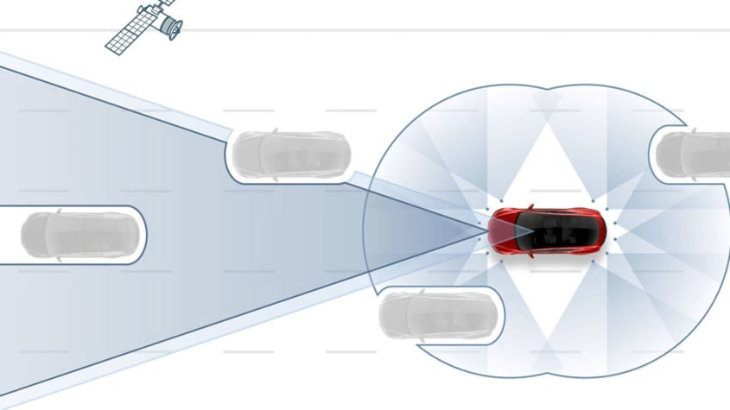
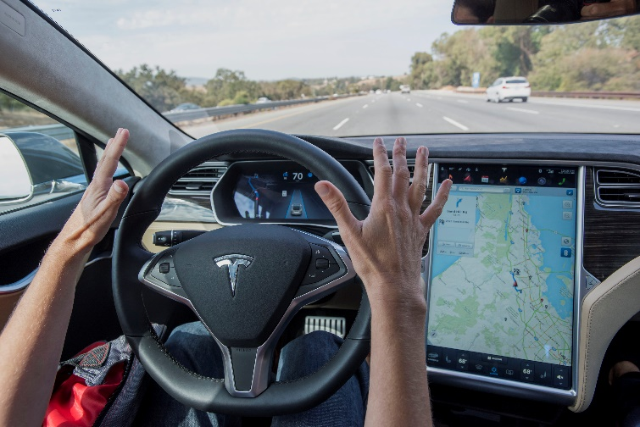
We are increasingly reliant on computers
... trusting them with our digital lives
Notes:
Our society is increasingly reliant on computers, and we are trusting these computers not only with our digital lives, but also with our physical lives.
Until a few years back, only planes used to have autopilots, but now in high-end cars have them too.

Slide 3
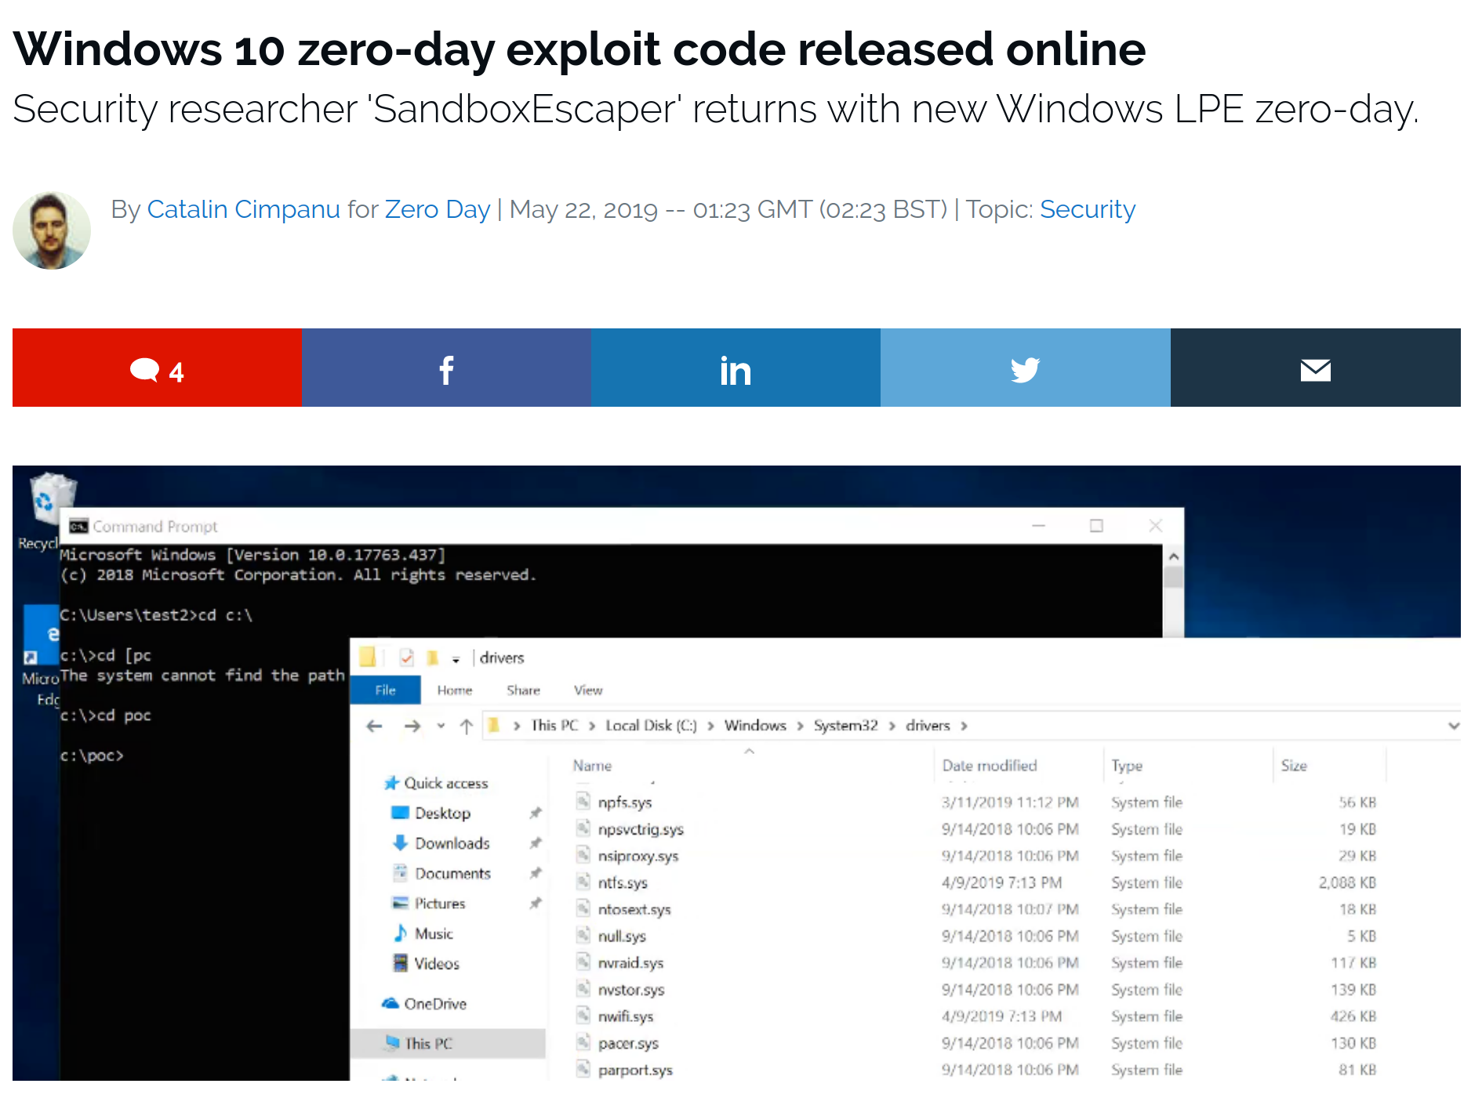
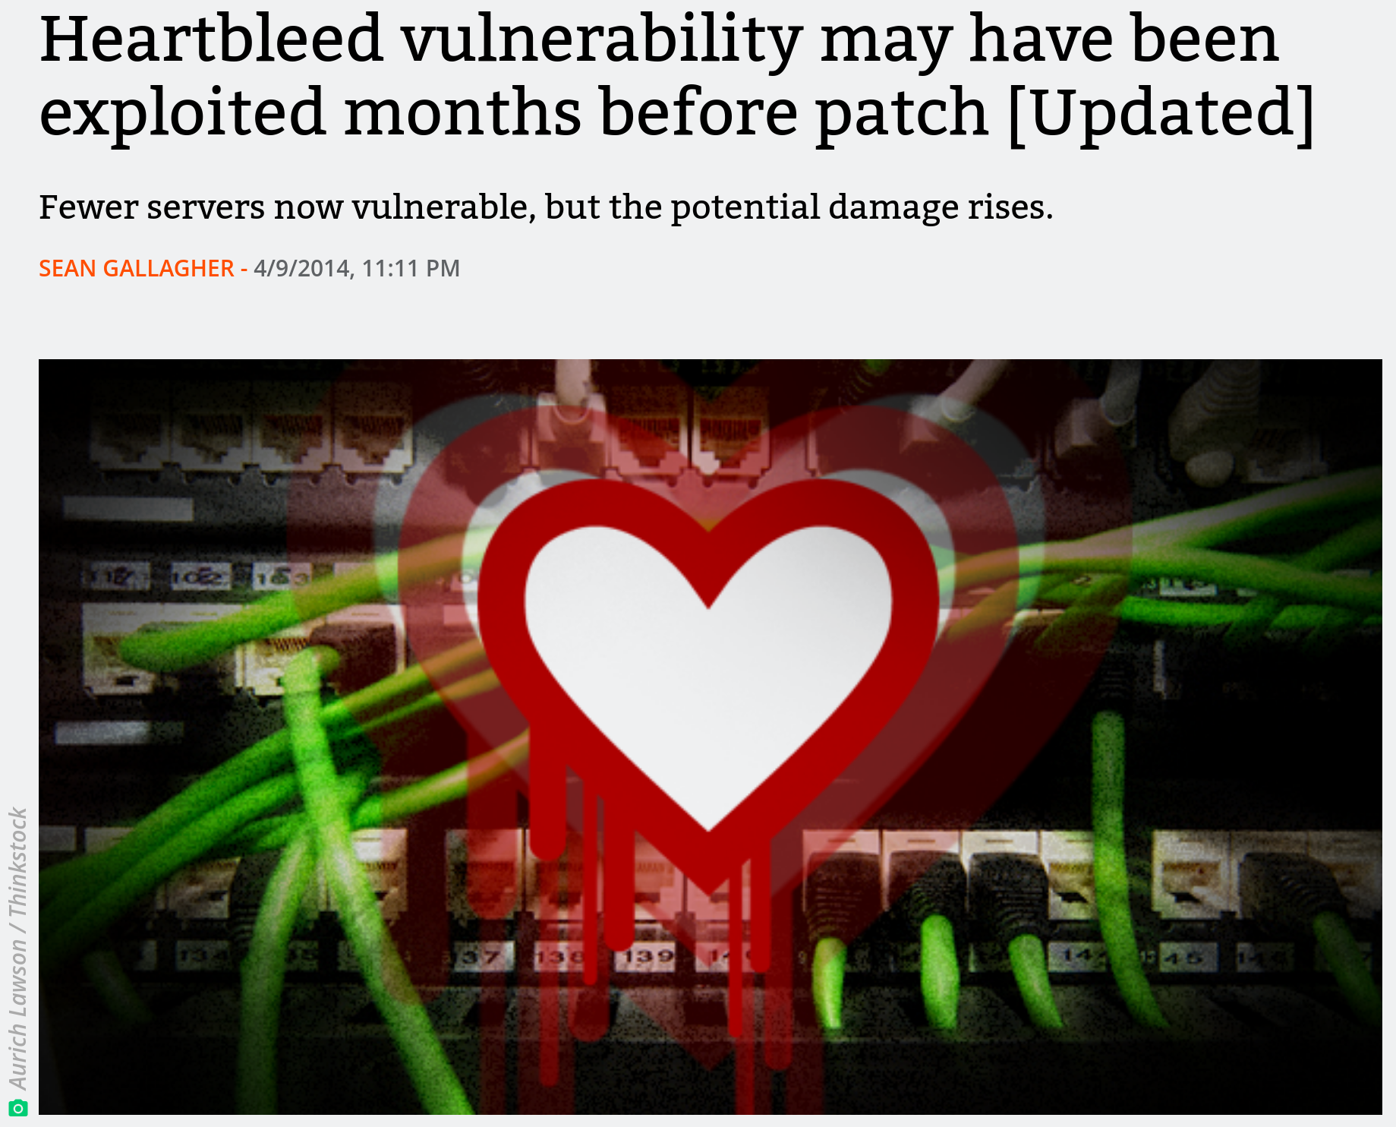
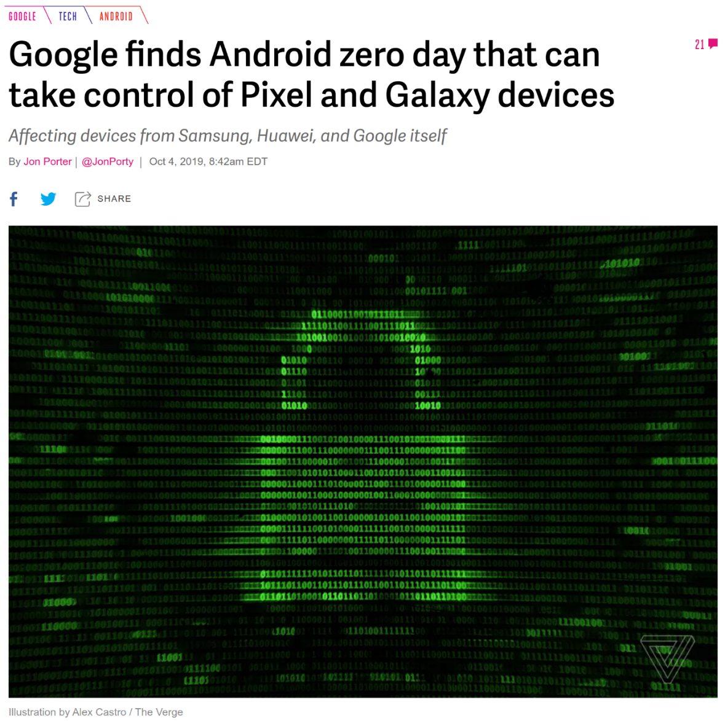
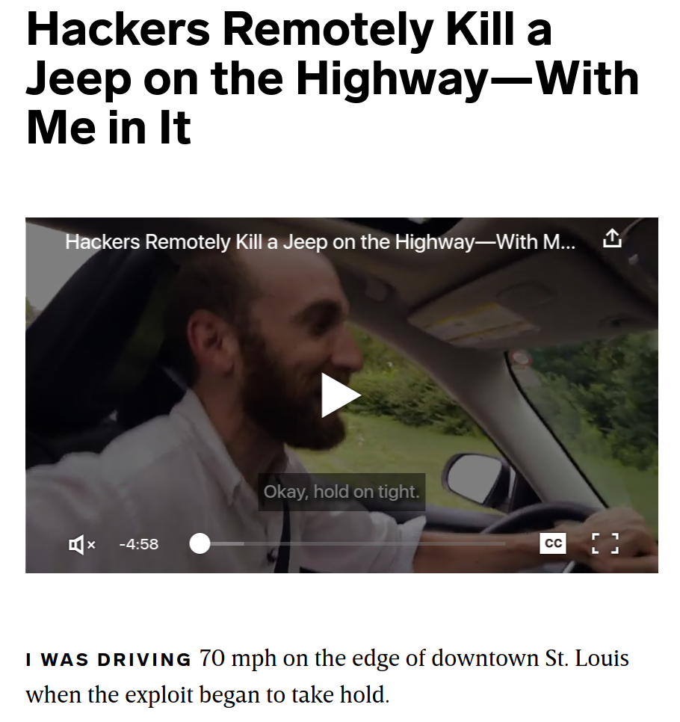
Computers vulnerable to hacking
Notes:
[Start]: Computers are, however, vulnerable to hacking.
[Precise explanation]: Hackers regularly exploit security vulnerabilities to take complete control of laptops, and servers, and phones, and even cars.
Researchers have demonstrated proof-of-concept attacks with they used to remotely turn off the breaks of a car going over 110 km/h.
[End]: We need to get out of this situation, and prevent from taking control of our computers.

Slide 4

Need to break the exploitation cycle
Once the stakes are high enough, attackers will find a way to exploit any vulnerability
Weak security defenses get deployed, but are routinely circumvented in practice
Security arms race
defenders find clever ways to "increase attacker effort"
attackers find clever ways around them
We need a deeper understanding that we can use to build provably secure defenses

Slide 5




Goal
Formal
Security
Proof
Enforcement
Notes:
I work on formal security, and for me formal security is about:
1. defining clear security goals
2. building effective security enforcement mechanisms targeted at these goals
3. and then tying the know by proving mathematically that the enforcement does achieve the security goals.

Slide 6




Overview of my recent research
Formally Secure Compartmentalizing Compilation [CSF'16, CCS'18, CSF'19] -- ERC Starting Grant SECOMP
Micro-Policies: Tag-Based Architecture [POPL'14, Oakland'15, ASPLOS'15, POST'18, CCS'18]
F* Program Verification System
[POPL'16,'17,'18,'20, ICFP'17,'19, ESOP'19, CPP'18, SNAPL'17]
QuickChick: Dependable Property-Based Testing
[POPL'17, ICFP'13, ITP'15, JFP'16]

Slide 7

Secure Compilation
New research area
bringing together people from different fields: formal methods, security, programming languages, compilers, systems, hardware, ...
Leading the effort of building this new community
high interest from people in the various fields
started with a small meeting in Paris in summer 2016 (10 participants)
since then 2 Dagstuhl Seminars, 4 Workshops (40-50 participants each)
Laying the formal foundations for part of this new area

Slide 8

Web browsers are frequently hacked
Browser gets its input from the internet: a webpage (spiegel.de)
300+ resources loaded: html, image files, javascript, styles, ...
from 25+ different internet servers
4 are clearly for ads:
- ad.doubleclick.net
- ad.yieldlab.net
- amazon-adsystem.com
- adalliance.io
content, scripts, libraries, fonts, tracking, ...:
cdn3.optimizely.com, cloudfront.net, meetrics.net, dyn.emetriq.de, fonts.gstatic.com, googleapis.com, imagesrv.adition.com, js-agent.newrelic.com, omny.fm, mxcdn.net, de.com, script.ioam.de, parsely.com, criteo.net, emsservice.de, xplosion.de, googletagmanager.com, omnycontent.com, summerhamster.com

Slide 9

Malicious server can hack the browser
send it an image that looks like an ad
specially crafted to exploit a vulnerability in the browser's image drawing engine
this compromises the whole browser
i.e. gives server complete control over it
malicious server can now:
steal the user's data
take control of the victim's computer
encrypt victim's data and ask for ransom

Slide 10
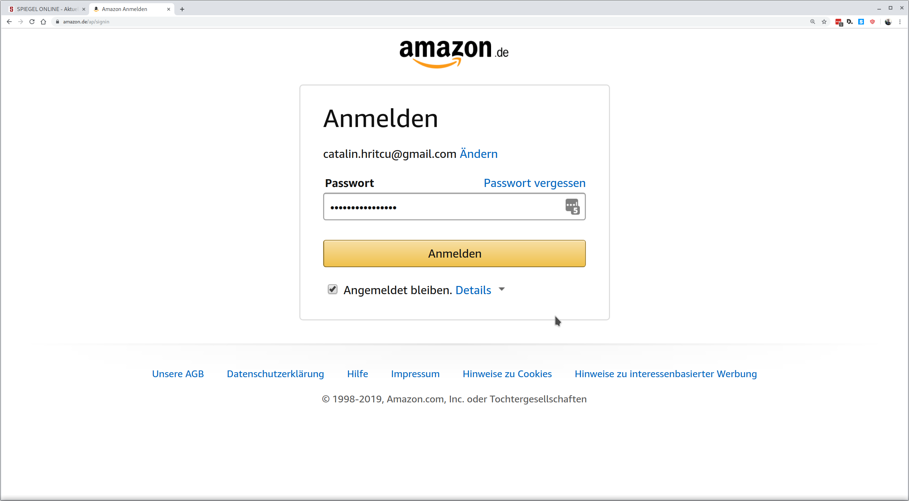

Compromised browser can steal user's data
I've just given my password to
the compromised browser
controlled by ad.doubleclick.net

Slide 11

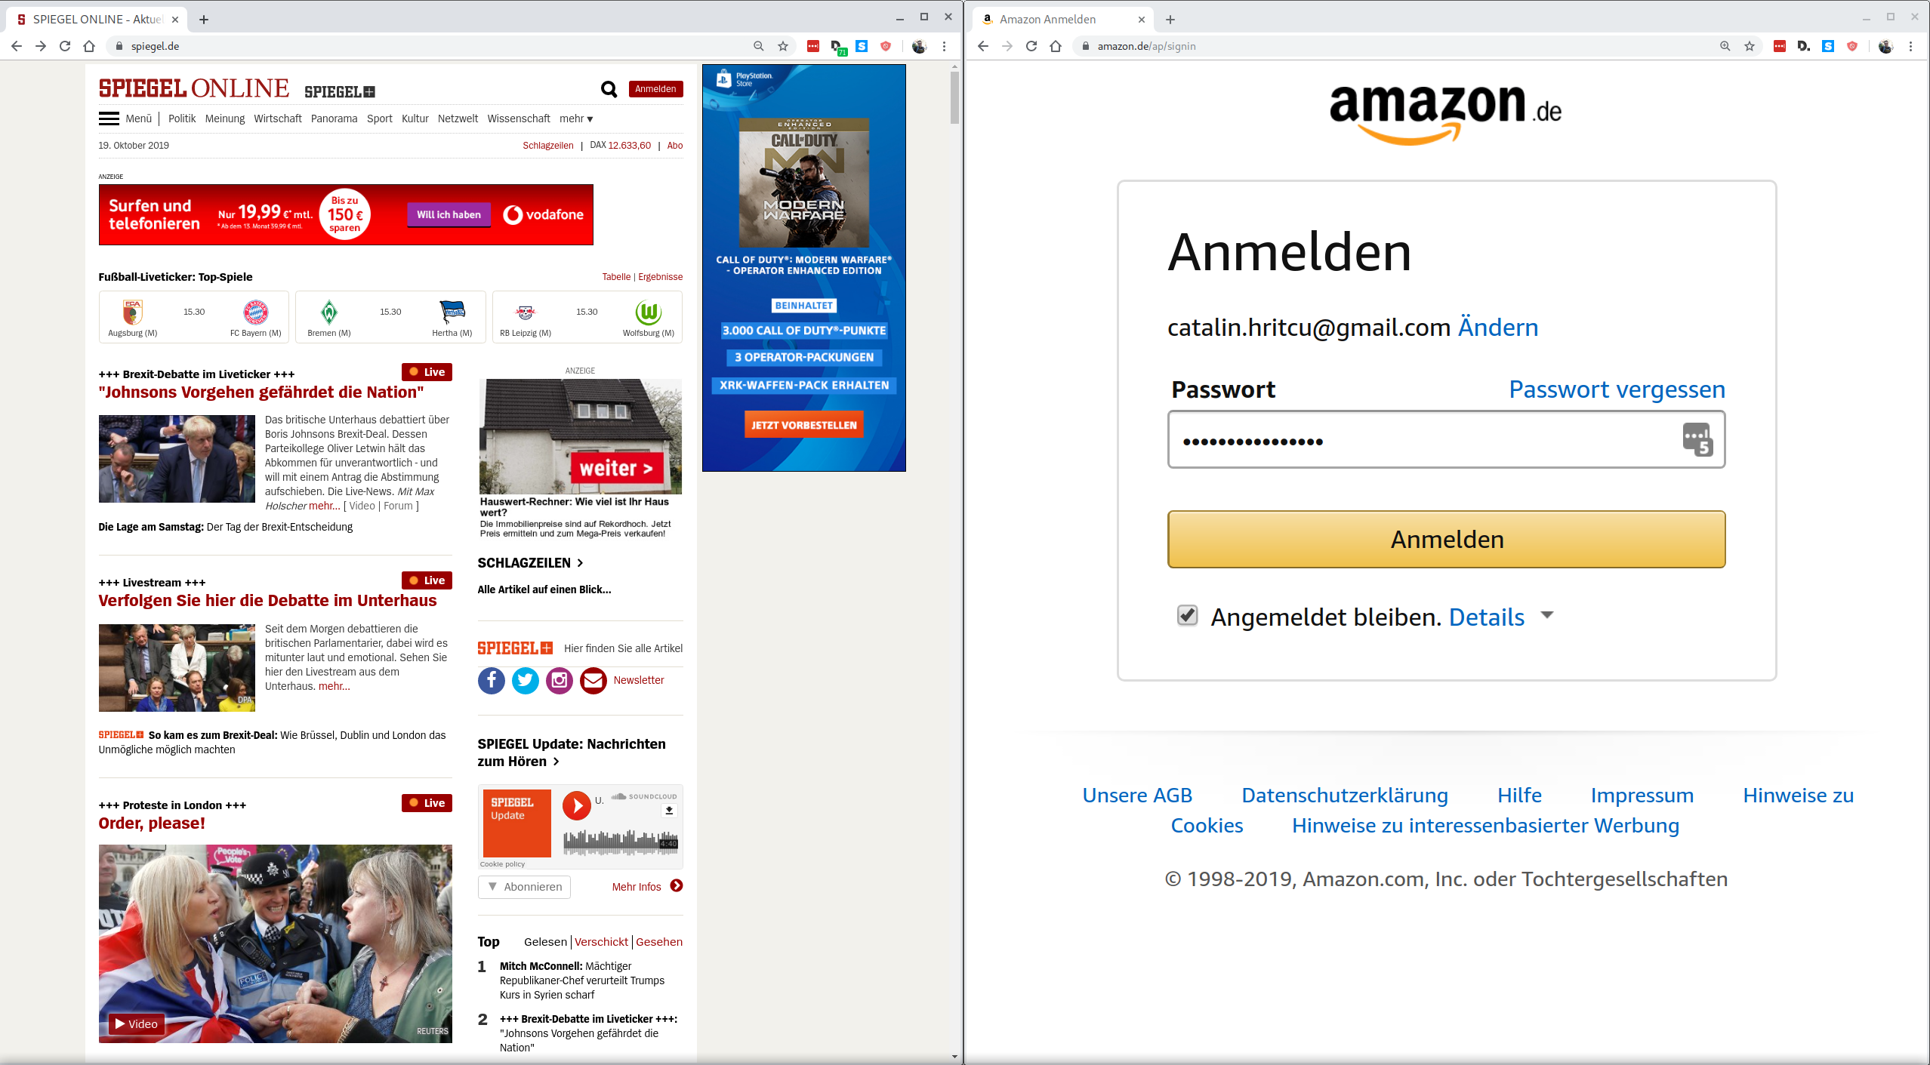
Compartmentalization can help
amazon.de password is still secure!
compromised
not compromised
compartment 1
compartment 2
Notes:
Explain better:
- the browser into separated into components, if one gets compromised the others don't get too much affected
- what happens within a component is as bad as before ... your spiegel pasowrd will be stolen

Slide 12
Good news: browsers now compartmentalized!
each tab indeed started in separate compartment
Bad news, so far:
limited compartmentalization mechanism
compartments coarse-grained
can compartmentalize tabs, but not secrets within a tab
compartments can't naturally interact
even for tabs this required big restructuring of web browsers
Notes:
TODO P2: some images

Slide 13

Fine-grained compartmentalization
spiegel.de
doubleclick.net
adalliance.io
spiegel.de

Slide 14
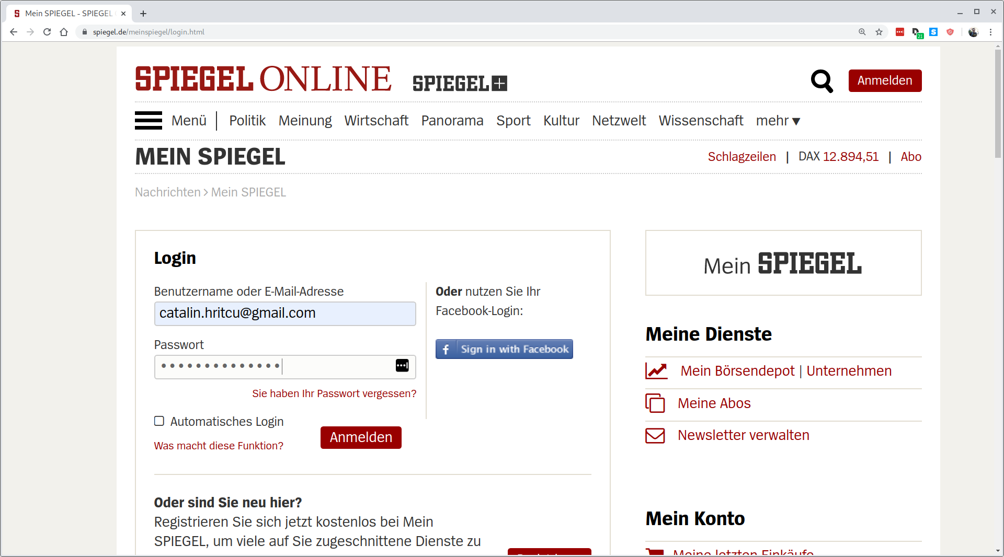

Fine-grained compartmentalization
spiegel.de
spiegel.de
facebook.com
spiegel.de
Spiegel.de password
is still protected

Slide 15

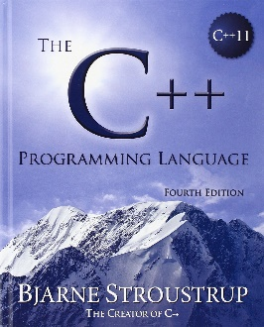
Source language compartments
Mozilla Firefox mostly implemented in C/C++
Programming languages like C/C++, Java, F*, ... already provide natural abstractions for fine-grained compartmentalization:
procedures, interfaces, classes, objects, modules, libraries, ...
a compartment can be a library/module/class or even an object (e.g., an image)
In the source language fine-grained compartments are easy to define and can naturally interact

Slide 16
Source language compartments
compartment C₁ {
private var x;
private procedure p() {
x := get_counter();
x := password;
}
}
compartment C₂ {
private var counter;
private var password;
public procedure get_counter() {
counter := counter + 1;
return counter;
}
}
←not allowed

Slide 17
Abstractions lost during compilation
Computers don't run C/C++, Java, or F*
Compiler translates Firefox from C/C++ to machine code instructions
All compartmentalization abstractions lost during compilation
no procedures, no interfaces, no classes, no objects, no modules, ...
Secure compilation
preserve abstractions through compilation, enforce them all the way down
Shared responsibility of the whole compilation chain:
source language, compiler, operating system, and hardware
Goal: secure compartmentalizing compilation chain
Notes:
TODO P2: add some picture

Slide 18
Machine-code level
Compartment C₁
<<check rx∈C₁>>
load r ← [rx]
put rc ← a_{password}
<<check rx∈C₁ or rx∈C₂'s interface>>
jump-and-link rx
sub r ← r-1
Compartment C₂
put rc ← a_{counter}
load r ← [rc]
add r ← r+1
store r → [rc]
jump ra
a_{counter} : 42
a_{password}: ...
←not allowed
compiled
get_counter
(public
procedure)
←not allowed
Securely enforcing source abstractions is challenging!
Notes:
TODO: maybe make code appear later? Or bring to the bottom? -- reduce back and forth between the data and code
At the machine-code level:
- the compiled code and data is stored in memory ... including the password
- should an instruction trying to load the password from memory be allowed?
- well, it depends on the which compartment does the load
- so we need to bring the compartment abstraction from the source to the machine-code level,
and split memory into compartments
- if the load of the password comes from another compartment it should not be allowed
...
Maybe: say that instructions are run in sequence
(Maybe one day: bring counter to top)

Slide 19
Formally Secure Compartmentalizing Compilation
Goal
Formal
Security
Proof
Enforcement

Slide 20
1. Security Goal
What does it mean for a compartmentalizing compilation chain to be secure?
formal definition expressing end-to-end security guarantees
these guarantees were not understood before
Will only show an easier definition
protecting a 1 trusted compartment from 1 untrusted one
untrusted compartment arbitrary (e.g. compromised Firefox)
trusted compartment has no vulnerabilities

Slide 21

This is not just hypothetical!
Mozilla shipping EverCrypt verified crypto library
(also used by Microsoft, Linux, ...)
Firefox
[POPL'16,'17,'18,'20, ICFP'17,'19, ESOP'19, CPP'18, SNAPL'17]
Formal verification milestone: 40.000+ lines of highly-efficient code, mathematically proved to be free of vulnerabilities (and functionally correct and side-channel resistant)
Notes:
End: and while I'm proud of this work, one needs to still put things in perspective.

Slide 22

Putting things into perspective
EverCrypt (verified in F*)
Firefox
40.000 lines
20.000.000 lines
+ external libraries
all unverified
Without compartmentalization interoperability is insecure: if Firefox is compromised it can break security of verified code
What does secure compartmentalization mean in this setting?

Slide 23


Preserving security against adversarial contexts
∀security property π
∀
F* context
EverCrypt
satisfies π
F*context
⇒
compiler
∀
machine code context
machine code
context
compiled
satisfies π
EverCrypt
protected
no extra power
Where "security property" can e.g., be integrity or confidentiality [CSF'19]
π = "EverCrypt's private key is not leaked"

Slide 24


Extra challenges for our real security definition [CSF'16, CCS'18]
Program split into many mutually distrustful compartments
We don't know which compartments will be compromised
every compartment should be protected from all the others
We don't know when a compartment will be compromised
every compartment should receive protection until compromised
Compartment 1
Compartment 1
Compartment 2
Compartment 3
Compartment 4
Compartment 4
Compartment 5
Compartment 5

Slide 25


2. Security Enforcement
Prototype compartmentalizing compilation chain
compartment C₂ {
private var counter;
private var password;
public procedure get_counter() {
counter := counter + 1;
return counter;
}
}
Compartmentalized source language
Buffers, procedures, compartments
Compartmentalized intermediate language
Intermediate language with
built-in compartmentalization
Programmable tagged architecture
Bare-bone machine
Machine code
Hardware-accelerated enforcement
+Software enforcement
[POPL'14, Oakland'15, ASPLOS'15, POST'18, CCS'18]

Slide 26
Software-fault isolation
Compartment C₁
<<check rx∈C₁>>
load r ← [rx]
put rc ← a_{password}
<<check rx∈C₁ or rx∈C₂'s interface>>
jump-and-link rx
sub r ← r-1
Compartment C₂
a₁: put rc ← a_{counter}
a₂: load r ← [rc]
a₃: add r ← r+1
a₄: store r → [rc]
a₅: jump ra
a_{counter} : 42
a_{password}: ...
←not enough
Idea: rewrite C₁'s (& C₂'s) code to insert all the required checks
Challenges: checks complicated (uncircumventable, efficient)

Slide 27

3. Security Proof
Proving mathematically that a compartmentalizing compilation chain achieves the security goal
formally verifying the security of the whole compilation chain
such proofs very difficult and tedious
wrong conjectures survived for decades; 250pg for toy compiler
we propose a more scalable proof technique
focus on machine-checked proofs in the Coq proof assistant
Coq proof for our prototype compiler for simple language
Scaling up such proofs to realistic languages like C and F* is my main direction of research (ERC SECOMP)

Slide 28


Summary
Compartmentalizing compilation is an important security defense in practice
1. Goal: formalize end-to-end security guarantees
first definition supporting mutually distrustful components and dynamic compromise
2. Enforcement: protect abstractions all the way down
software fault isolation or tag-based architecture
3. Proof: verify security of entire compilation chain
scalable proof technique machine-checked in Coq
Notes:
To sum up: compartmentalization is an important security defense in practice that allows us to limit the damage of exploitable vulnerabilities.
In this work we formalize the end-to-end security guarantees of fine-grained compartmentalization. We are the first to give a definition of secure compartmentalizing compilation that supports mutually distrustful components and dynamic compromise.
...

Slide 29
Backup Slides

Slide 30





Cătălin Hrițcu
[2005-2011] MSc & PhD @ Saarland University, Saarbrücken, Germany
[2011-2013] Research Associate @ University of Pennsylvania, USA
[2013-now] Tenured Researcher @ Inria Paris, France
[2016] Visiting Researcher @ Microsoft Research, Redmond, USA
[2019] Habilitation à diriger des recherches @ ENS Paris, France
Publications (30+ papers, 1500+ citations)
Best venues in security (4×CSF, 2×Oakland S&P, 2×CCS, 2×JCS) and programming languages (6×POPL, 4×ICFP, 1×ASPLOS, 1×ESOP, 2×JFP)
Software Foundations teaching programming languages & logic with Coq
PC chair CPP'20, SC and PC chair PriSC, GC EuroS&P'17, AEC chair POPL'18,'19
PC member for CSF'20, SecDev'19, CCS'18, EuroS&P'18, ESOP'18, POPL'17, ...
Notes:
SAY (start): I did my PhD in Saarbrucken, then a PostDoc at UPenn, and in 2013 I joined Inria Paris as a permanent researcher.
SAY: I am the author of over 20 papers published at ... and of the widely-used Software Foundations textbook
SAY: I am currently supervising 2 PhD and 3 Master’s students.
SAY (end): I’m the general of EuroS&P and on the PC of many good conferences including POPL and CSF.

Slide 31



My Research
λ
Devising formal methods
programming languages
type systems, logics
verification systems
proof assistants
property-based testing
Solving security problems
precise security goals
clarify attacker models
provably secure systems
stopping low-level attacks
enforcing security policies
Resulted in various innovative tools
Micro-Policies, F*, QuickChick, ...
Notes:
SAY (start): My research is focused on developing rigorous formal techniques for solving security problems
SAY (end): Finally, my research has resulted in many innovative tools that I will leverage for this project.
NO: Add logos of tools? Then would have the tools for formal methods – or just keep as is
NO: find better formal methods icon: logic formulas, logical deduction rules, types / typing rules, math, a big lambda, etc

Slide 32

Research group at Inria Paris
4 PhD students: Kenji Maillard (graduating soon), Guido Martinez (Rosario), Carmine Abate, Jérémy Thibault
1 Starting Researcher: Exequiel Rivas
2 PostDocs: Roberto Blanco, Adrien Durier
4 Interns/Engineers: Cezar Andrici, Théo Laurent, Antoine Van Muylder, Ramkumar Ramachandra
1 Visiting Professor (Chile): Éric Tanter
Past: 1 Graduated PhD student, 2 PostDocs, 3 Engineers, 3 Visiting Professors/Researchers, and ~17 Interns

Slide 33

Funding and collaborators
SECOMP: Efficient Formally-Secure Compilation
Funding: ERC Starting Grant (2017 -- 2021)
Collaborators: UPenn, CMU, MPI-SWS, Univ of Chile, ...
Micro-Policies: Tag-Based Reference Monitors
Funding: DARPA SSITH/HOPE (2018 -- 2020)
Collaborators: Draper, Dover, UPenn, MIT, PSU, ...
F* Language for Program Verification
Funding: Everest Expedition via MSR-Inria (2017 -- 2020)
Funding: Tezos Foundation Grant (2019 -- 2021)
Collaborators: Microsoft Research, CMU, Princeton, MIT, ...

Slide 34

Research direction: secure compilation at scale
language
EverCrypt
C & Rust languages
+ components
+ memory safety
safe Rust component
legacy C component
ASM language
(RISC-V + micro-policies)
ASM component
Notes:
Derek: research vision should come earlier (23, 24)
SAY (beginning): The dream is to achieve secure compilation at scale at scale for realistic programming language

Slide 35
Security definition:
i₀
i₁
i₂
If
C₀
C₁
C₂
⇝ t
then
↓
↓
↓
∃ a sequence of component compromises explaining the finite trace t in the source language, for instance t=m₁·m₂·m₃ and
i₀
i₁
i₂
(1)
C₀
C₁
C₂
⇝* m₁·Undef(C₁)
↯
i₀
i₁
i₂
(2)
∃A₁.
C₀
A₁
C₂
⇝* m₁·m₂·Undef(C₂)
↯
i₀
i₁
i₂
(3)
∃A₂.
C₀
A₁
A₂
⇝ m₁·m₂·m₃
Notes:
TODO: bring static compromise variant as backup slide

Slide 36
Programmable Tagged Architecture
Compartment C₁
load r ← [rx]
put rc ← a_{password}
jump-and-link rx
sub r ← r-1
Compartment C₂
a₁: put rc ← a_{counter}
a₂: load r ← [rc]
a₃: add r ← r+1
a₄: store r → [rc]
a₅: jump ra
a_{counter} : 42
a_{password}: ...
@Entry
@NoEntry
@NoEntry
@ ...
pc@C₂
,n
pc@C₁
@Ret(n-1)
@NoEntry
Challenge: making sure returns go to the right place
[POPL'14, Oakland'15, ASPLOS'15, POST'18, CCS'18]
Notes:
TODO: move to backup
TODO: explaining quite a lot in the air -- monitor ... maybe stay high-level and don't explain that
TODO: Explain returns much better, or not at all

